Slide 1
Creating Statewide Longitudinal Data Systems (SLDS) That Provide Useful Information A Four-Part Webinar Series
October 2025 -February 2026

Slide 2
Webinar 2: Empowering Individuals with Data Leveraging Statewide Longitudinal Systems to Provide Real-Time Information
November 21, 2025

Slide 3
Agenda
Introduction of our framework
Key considerations for supporting individuals
Lessons from California
Panel discussion
Q&A

Slide 4
Who we are
Actionable Intelligence for Social Policy (AISP)
Data Quality Campaign (DQC)
Education Commission for the States (ECS)
WestEd’s Data Integration Support Center (DISC)

Slide 5
What is an SLDS?
1
2
3
4
Systems connect data
Data are linked at the individual level
Data are longitudinal
Data security and privacy are core requirements

Slide 6
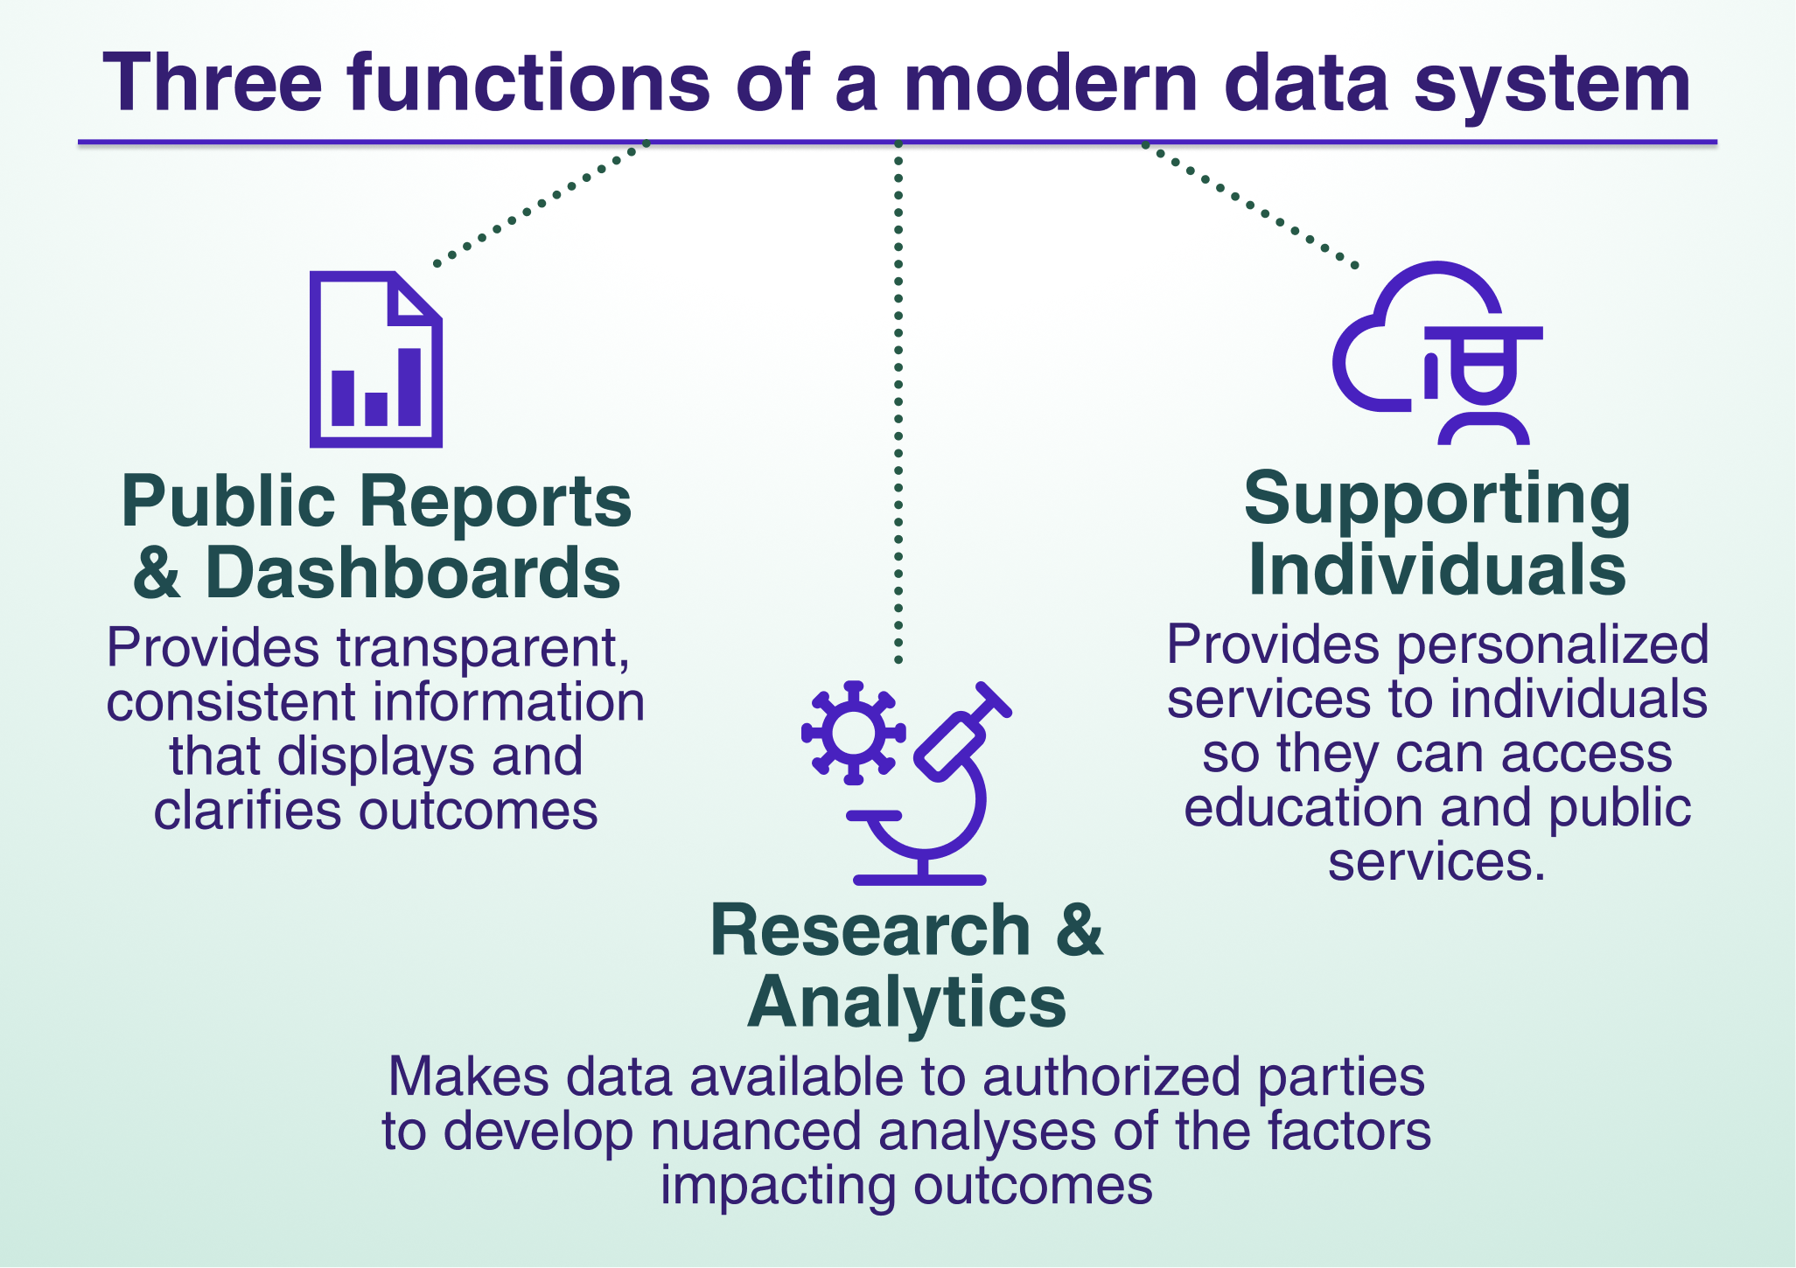
Read more about the functions at https://bit.ly/3-functions

Slide 7
Why the Functions Framework Matters & How It Helps States
Shows how the SLDS serves people and informs decisions, rather than being a technology project
Encourages states to let purpose drive design, not structure
Supports states in aligning technical, legal, and governance frameworks with the services people need
Clarifies how data systems can be designed to provide actionable information for learners, policymakers, and communities

Slide 8
Webinar Series: Creating an SLDS That Provides Useful Information
Helping state leaders maximize the potential of their SLDS
Focus on user-centered design rather than tech-only solutions
Support states in building actionable and transparent data systems
Share practical, plain-language strategies states can apply immediately

Slide 9




Webinar Series
Webinar 1
So, You Want a State Dashboard?
Webinar 2
Empowering Individuals with Data
Webinar 3
Maximizing the Power of Research & Analytics
Webinar 4
Bridging Education to Workforce

Slide 10
Features of the Supporting Individuals Function
PROS
Effective at helping individuals navigate complex systems while privacy is protected
Allows individual-level data to be transferred between institutions
Provides data in near real time
CONS
Information can only be shared with authorized users (counselors, admissions)
State and federal privacy laws may require gathering consent and managing notification procedures
Usually requires information to be provided by individual institutions (like school districts) rather than state agencies because agencies do not have real-time data

Slide 11
Key Considerations for the Supporting Individuals Function
Audiences
Learners and their families, counselors, admissions
Goals
Efficiency, remove administrative burdens to allow more learners to access public systems
Opportunity
Allows more people to navigate complex systems
Interface
Plain language, intuitive visuals for interaction with learners
Tailored information exchanges to support processes (completion of eligibility requirements)
Usability
Engage with institutions to clarify the value to increase access and reduce administrative workload
Sustainability
Direct engagement with institutions to troubleshoot data quality issues, ensure ongoing participation, and address emerging security issues

Slide 12
Common Challenges for the Supporting Individuals Function
Infrastructure
Analytical data sets rarely contain the required information or produce data that is timely for administrative purposes
Legal agreements may not allow for exchange of identifiable data
Data Interoperability and Quality
Information may be stored in different formats at the local level
Information may be of poor quality, requiring changes to local data management
Lack of Use
Incentives are required to get institutions and vendors to use the tools
Local providers need support to understand how to use the data to help learners

Slide 13
How can states leverage SLDS infrastructure to support individuals? Expert Panelists
Mary Ann Bates
Office of Cradle-to-Career Data
Mary Aguayo
California College Guidance Intiative

Slide 14
California Cradle-to-Career Data System
Who We Are
The California Cradle-to-Career Data System provides data-informed tools to help students reach their college and career goals and deliver information on education and workforce outcomes. This user-friendly system includes resources focused on early learning through K-12 and higher education, as well as on the financial aid and social services that help students reach their goals.
Why was it built?
California’s information on early education, K-12 schools, colleges, social services, and employment is often separate and disconnected.
It is difficult to share information to support planning and transitions for students.
It has not been possible to explore the outcomes of Californians–from early childhood through adulthood–and the factors that help shape their outcomes, all in one place.
To be a trusted and neutral source of actionable data, tools, and services to support navigation of academic and employment pathways for students, families, and communities.

Slide 15
California College Guidance Initiative
Who We Are
Manager of CaliforniaColleges.edu, the State of California’s official college and career planning platform and a named Operational Tool incubated in the Cradle-to-Career Data System (California Education Code 10867)
A legislatively-authorized service provider to all California school districts (California Education Code 60900.5)
Our Goal
Systematize access to college and career knowledge development tools and streamline college and financial aid processes for students. Provide actionable data to empower educators in supporting 6th–12th-grade public school students’ college and career success.

Slide 16
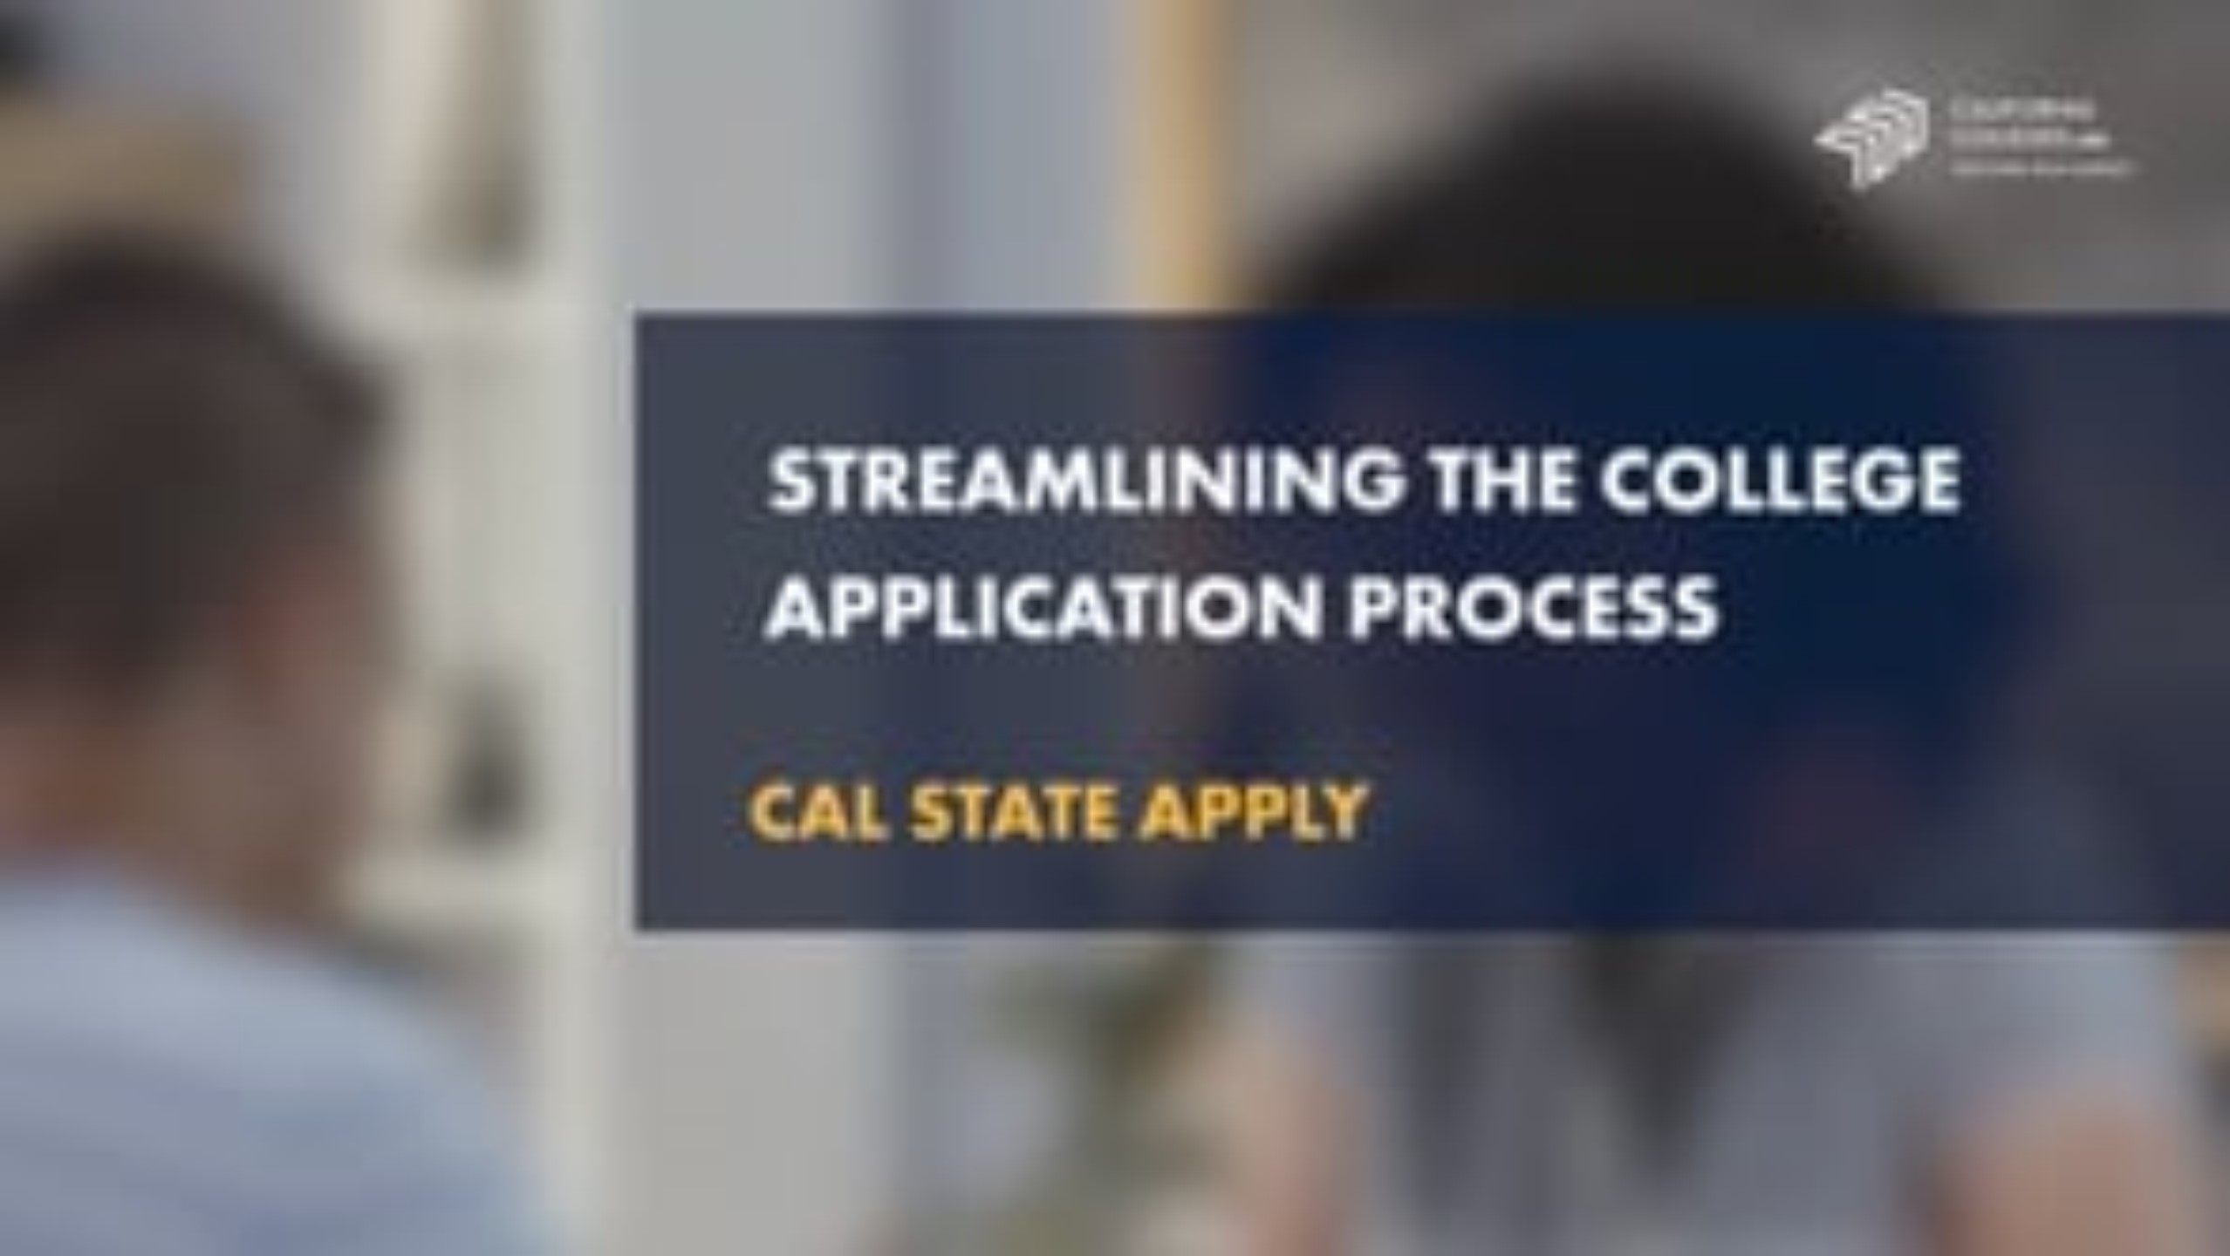

Slide 17
Our Questions for Panelists
An Informed Conversation

Slide 18
Q&A
Please Submit questions
using the Questions tab at the bottom of your zoom

Slide 19

Next Steps
WestEd will send you an email with links to other webinars in the series
You can view and share this webinar
Next Webinar on the Research & Analytics Function will be December 17
Notes:
https://docs.google.com/forms/d/13g80JQD71qSR_p3j7ieyLUaLZ8zHKU9ImO0Z6Xnn6Fo/preview

Slide 20
Thank you!
Stay in touch with by emailing us at DISC@wested.org or by visiting us at DISC.WestEd.org

Slide 21
Appendix SLIDES: C2C

Slide 22
California
Cradle-to-Career
Data System
Mary Ann Bates, Executive Director

Slide 23
C2C’s Purpose
“There is hereby established in state government the California Cradle-to-Career Data System for the purpose of connecting individuals and organizations to trusted information and resources. The data system shall be considered a source for actionable data and research on education, economic, and health outcomes for individuals, families, and communities, and provide for expanded access to tools and services that support the navigation of the education-to-employment pipeline.”
Education Code 10860(a)

Slide 24
Background
2019: California enacted the Cradle-to-Career Data System Act, which called for the establishment of a state longitudinal data system to link existing education, social services, and workforce information.
2020-2021: A collaborative 18-month planning process. 100+ public meetings.
2021: AB 132 established the Cradle-to-Career Data System in the Government Operations Agency and the Governing Board was seated.
2022-2023: Design, build, and implementation, first data submission and ingestion.
2024: Public engagement and completed build of data system’s first phase.
2025: Release of Student Pathways Data Story

Slide 25
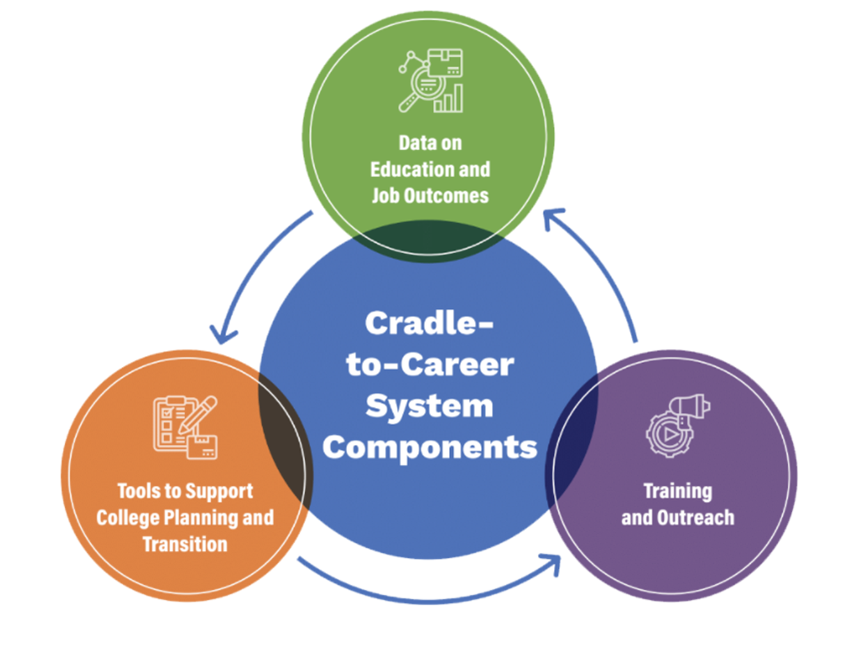
C2C Data System

Slide 26






Why is this work needed?
Linking data across institutions
Center the needs of students and families
Improve understanding

Slide 27
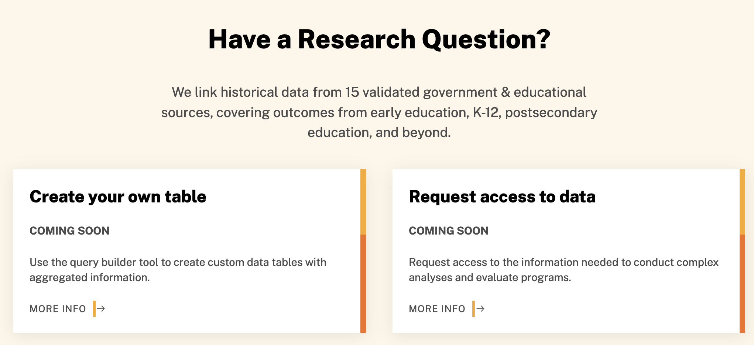
Analytical Data Tools
Three ways to access:
Dashboards
Query builder
Research request process
https://c2c.ca.gov/

Slide 28
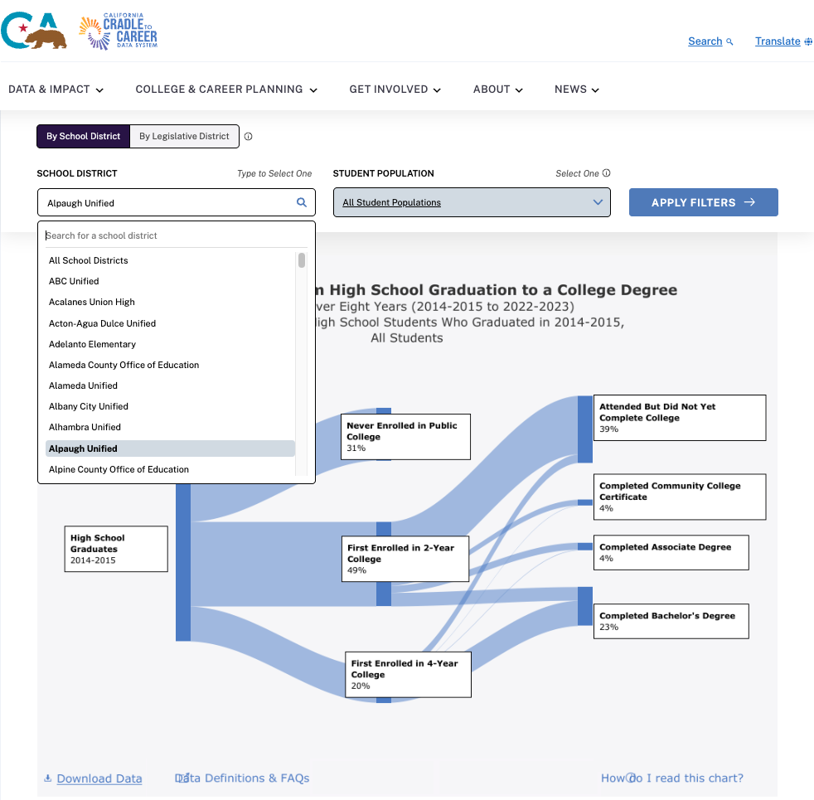
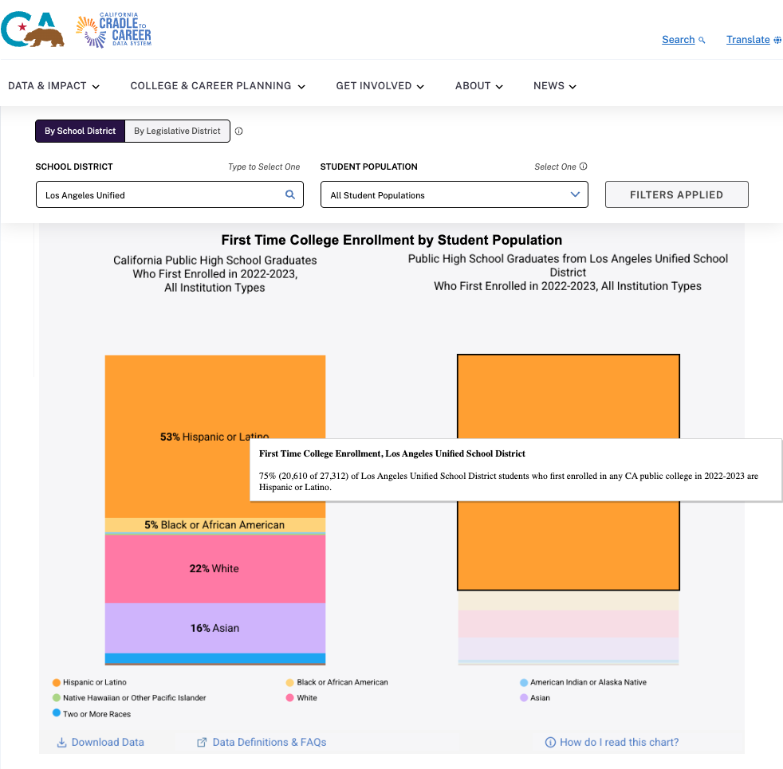
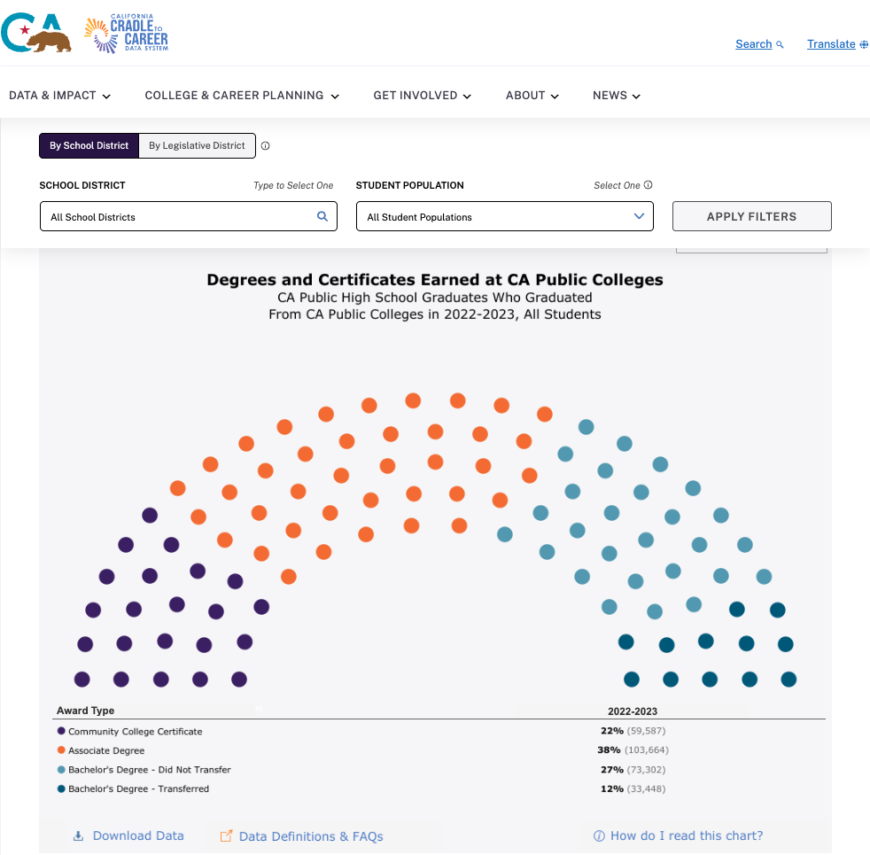
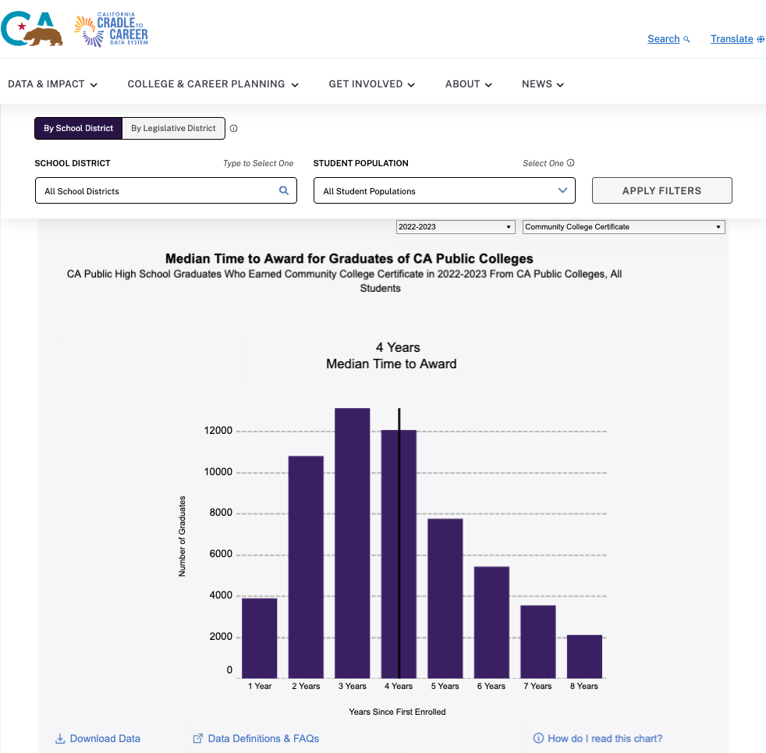
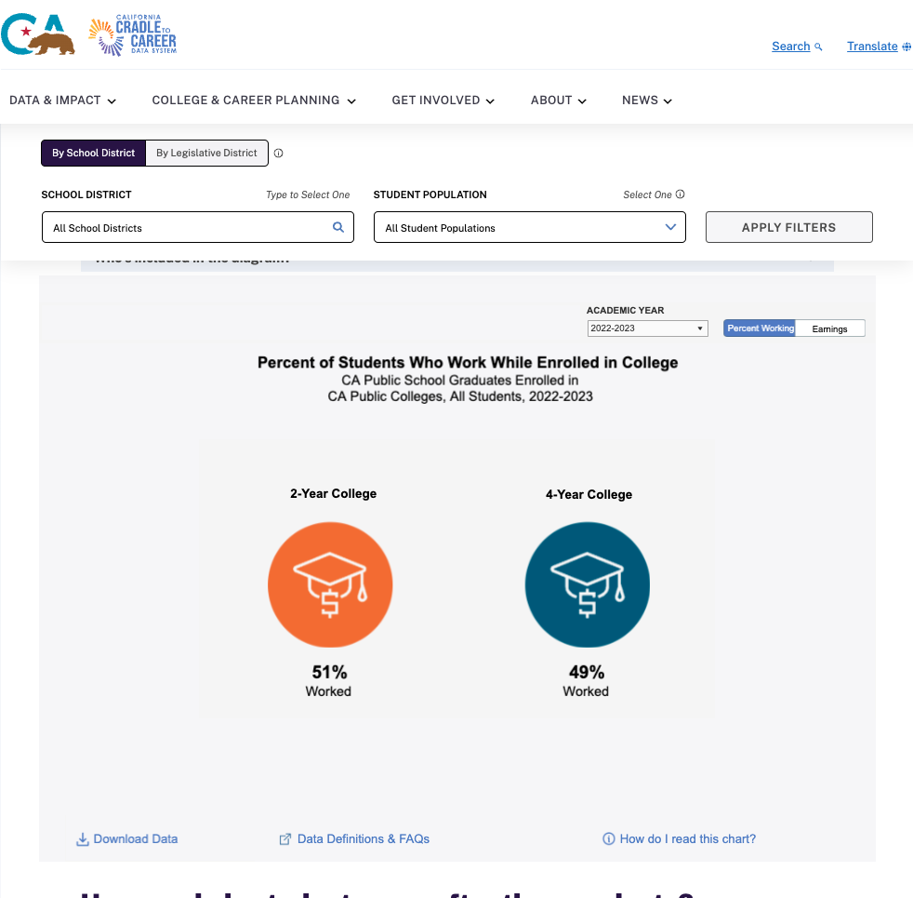
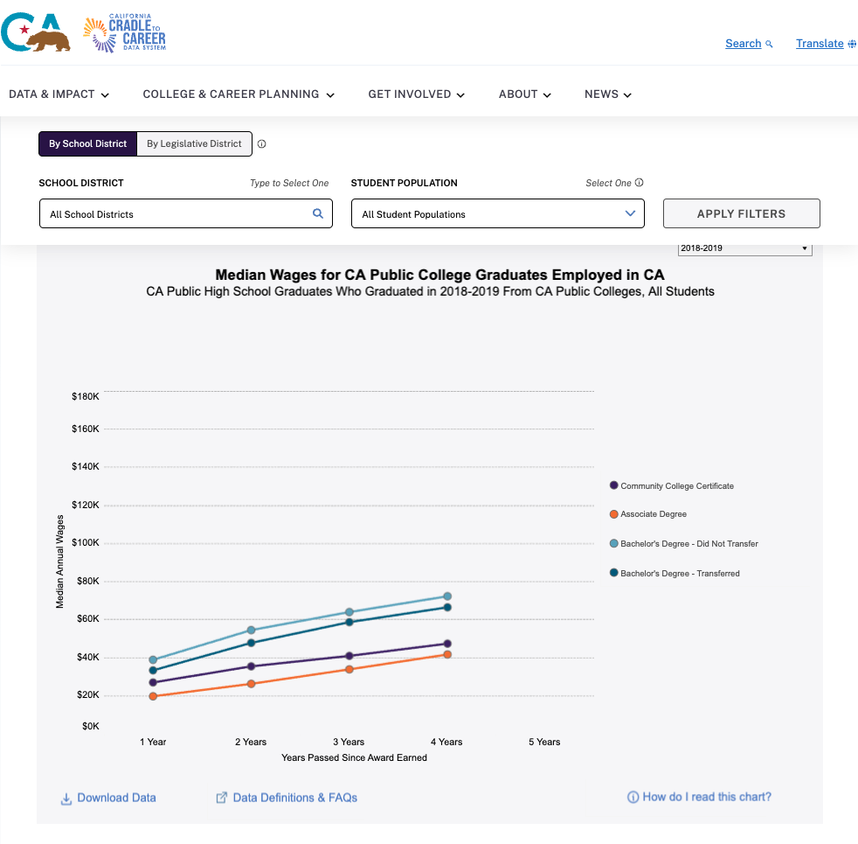
Student Pathways Dashboard

Slide 29
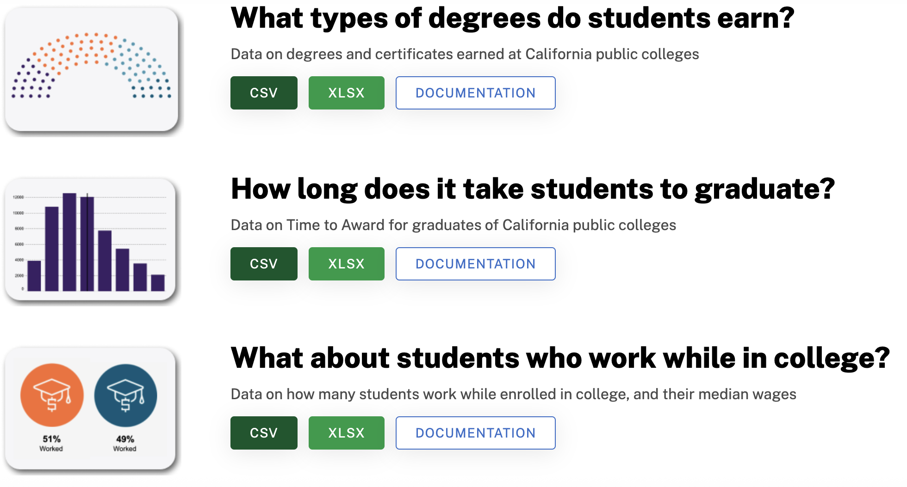
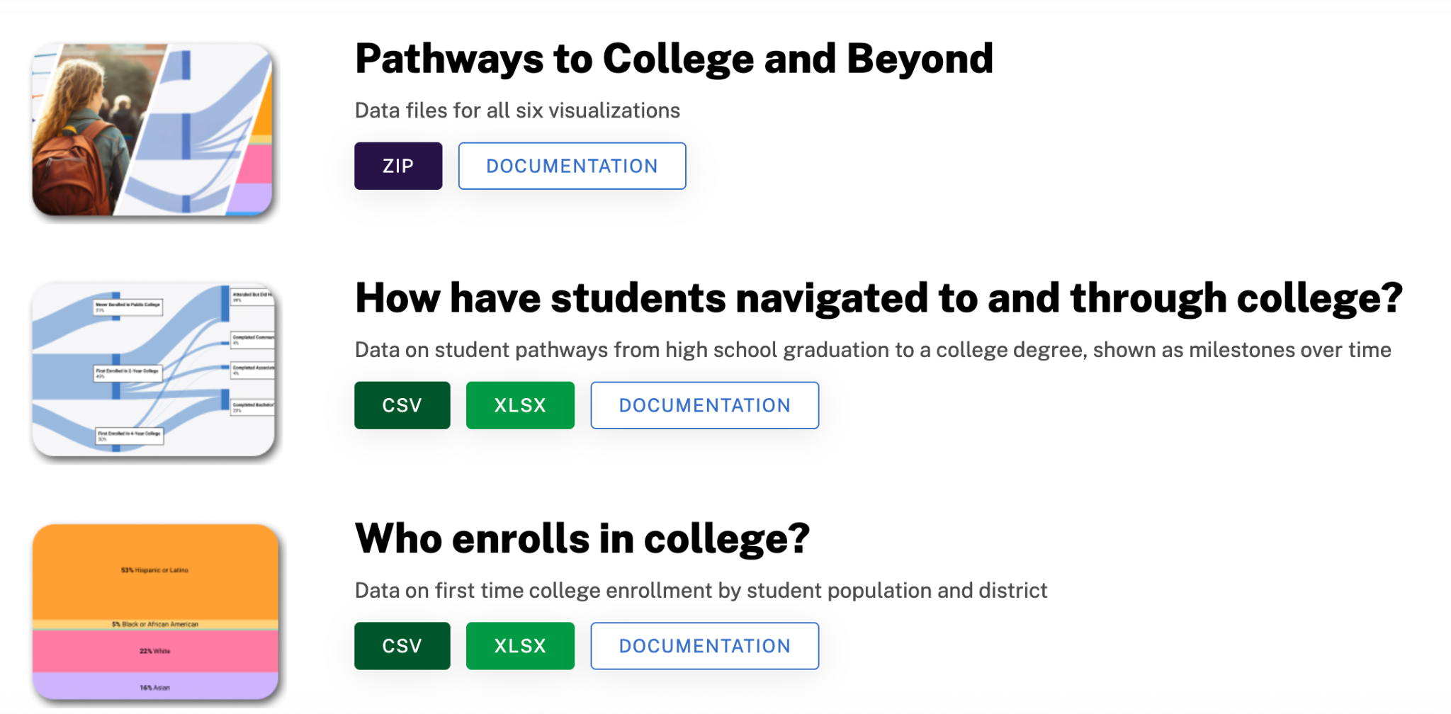
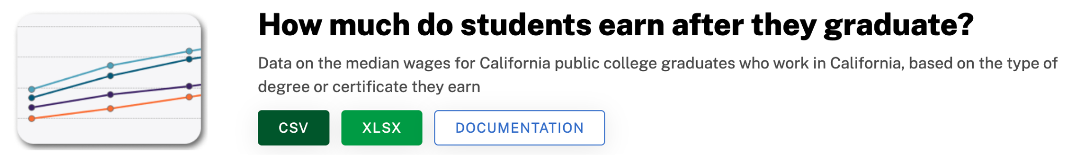
Query Builder: Student Pathways Dataset

Slide 30


Supporting Individuals Use Case
Scaling practical tools that directly support students
Finding innovative uses of the P20W Dataset
CalKIDS data sharing project

Slide 31


Practical Tools
When C2C launched, statute contemplated working with partners scaling tools used by students and educators,
Two named tools in statute:
CaliforniaColleges.edu
ETranscriptCA

Slide 32
Partnership with CCGI
❖Separate data infrastructure for separate use case:
➢Linked longitudinal data for analytical purposes
➢Real-time data for serving students
❖Californiacolleges.edu is managed and operated by CCGI
❖CCGI and C2C work with the same partners
❖C2C has championed CCGI’s scaling using an incubation model

Slide 33
Key Takeaways
C2C’s collaborative governance structure created a space for accelerating collaboration among C2C’s data partners and CCGI
State structures and systems are the key for state-wide scale
Example: updated Education Code brings CCGI to state-wide scale by 2026.

Slide 34

CALKIDS
C2C can bridge the information gap by linking CDE data, CALKIDS account information with CCC enrollment data to enable targeted outreach to encourage uptake of unclaimed CALKIDS funds
Notes:
By linking CDE, CCC and SIB data to produce individual level files for CCCCO, they can perform target outreach to students about unclaimed scholarship funds.
Adding CALKIDS information to CCGI financial aid lessons including how to find SSID on Californiacolleges.edu

Slide 35


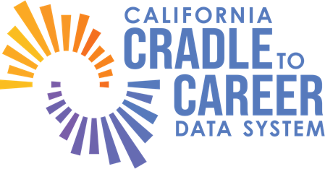














Signatories of Data Sharing Agreement

Slide 36
Appendix SLIDES: CCGI

Slide 37
Webinar 2: User Centered SDLS Design: Empowering Individuals with Data
November 21, 2025
Mary Aguayo Chief Executive Ofﬁcer

Slide 38


California College Guidance Initiative (CCGI)
Who We Are
Manager of CaliforniaColleges.edu, the State of California’s ofﬁcial college and career planning platform and a named Operational Tool incubated in the the Cradle-to-Career Data System (California Education Code 10867)
A legislatively-authorized service provider to all California school districts (California Education Code 60900.5)
CaliforniaColleges.edu is managed by the California College Guidance Initiative. © 2025 California College Guidance Initiative. All rights reserved.
38

Slide 39
Our Three Big Goals
To ensure access to higher education, we seek to:
Provide access to high-quality college and career knowledge development tools for all 6th-12th grade public school students
Systematize
Streamline
Create an integrated college and ﬁnancial aid application process for California students and educators
Provide Data
Supply the actionable data educators need to provide targeted interventions and inform decisions as they provide high-stakes college and career support
CaliforniaColleges.edu is managed by the California College Guidance Initiative. © 2025 California College Guidance Initiative. All rights reserved.
39

Slide 40





A One-Stop Shop for Students and Educators Everything in one place: from their ﬁrst career exploration activities in 6th grade, to college and ﬁnancial aid applications in 12th grade, students get access to numerous college and career planning tools.
Features of California Colleges.edu
Designed for California Students
The platform moves with students within the state, and unique integrations with the state’s public higher education and ﬁnancial aid systems streamline the college application process.
Intentional Tools for Educators
Timely reports help educators provide universal student support, identify targeted interventions, and meet statewide standards.
Tailored Support for Districts
Individualized partnership and training designed to meet district’s individual needs and goals.
CaliforniaColleges.edu is managed by the California College Guidance Initiative. © 2025 California College Guidance Initiative. All rights reserved.

Slide 41
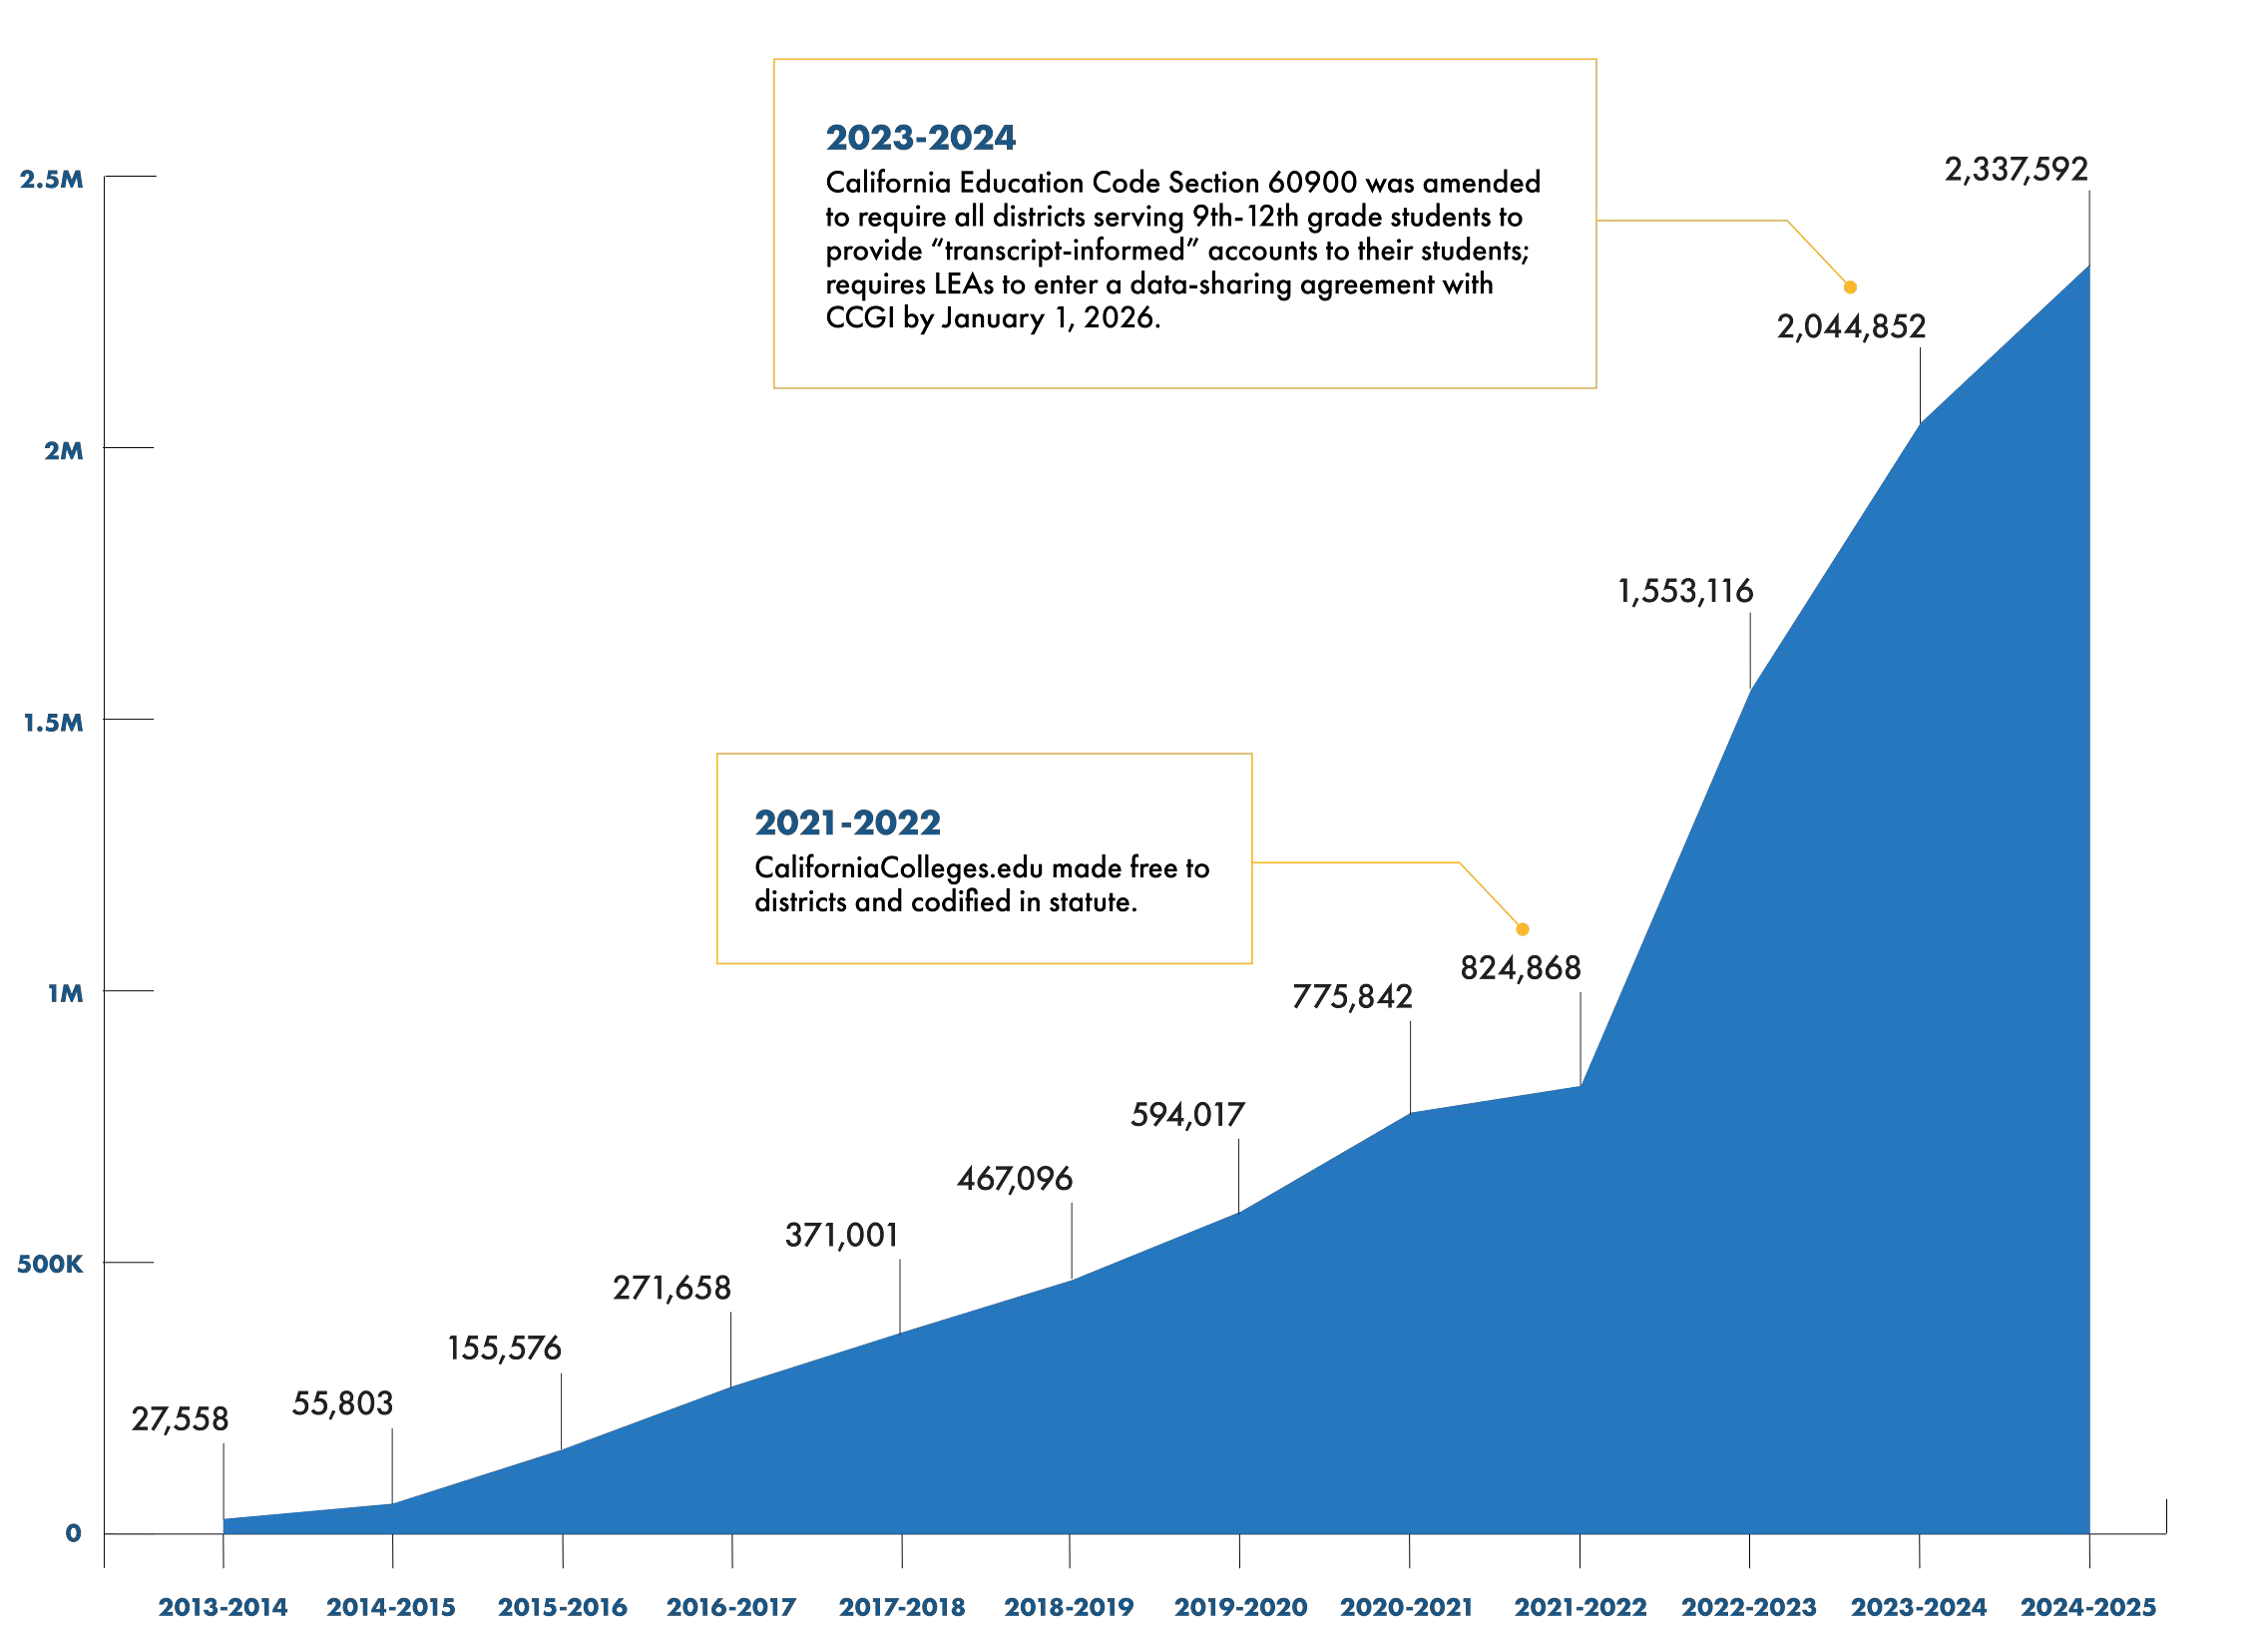

Universal Access to CaliforniaColleges.edu
NUMBER OF STUDENTS ENROLLED IN PARTNER LEAS (6–12)
Legend
The total number of 6th-12th grade students
enrolled in California public schools in partnership
ACADEMIC YEAR
CaliforniaColleges.edu is managed by the California College Guidance Initiative. © 2025 California College Guidance Initiative. All rights reserved.

Slide 42

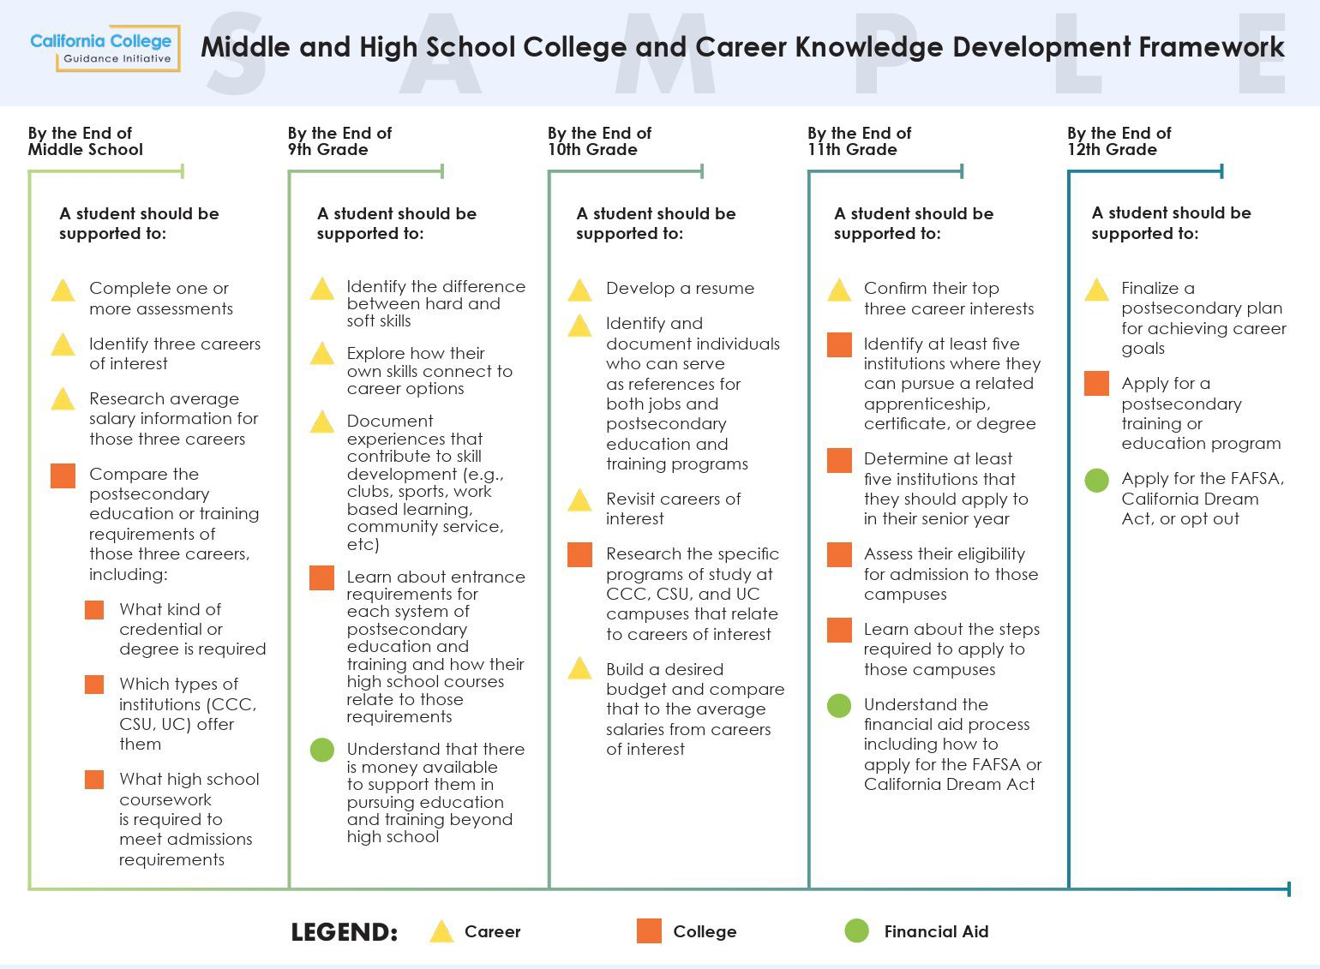
College and Career Knowledge Development Framework
CaliforniaColleges.edu is managed by the California College Guidance Initiative. © 2025 California College Guidance Initiative. All rights reserved.

Slide 43

Usage Change Since Ed. Code Codiﬁcation
Student Usage
100% | Increase in student logins to CaliforniaColleges.edu between AY 2021-2022 and AY 2024-2025. Students logged in more than 2.1 million times in AY 2024-2025.
College and Career Planning
Between AY 2021-2022 and 2024-2025, students across the state increasingly used CaliforniaColleges.edu’s college and career planning tools to further their postsecondary goals. 131% Increase in Number of Individual 117% Increase in Number of Individual u Students Who Favorited at Least Students Who Favorited at Least One College Between AY 2021-2022 One Career Between AY 2021-2022 262,597 Students ^{and AY 2024-2025} 215,602 Students ^{and AY 2024-2025} (AY 2024-2025) (AY 2024-2025) N
Califor
iaColleges.edu is managed by the California College Guidance Ini
tiative. © 2025 California College
Guidance Initiative. All rights reserved.
7

Slide 44
Connected College Applications
Institution | Connected Applications (2024-2025 AY)
California State University | 243,147
University of California | 252,499
California Community Colleges | 218,602
CaliforniaColleges.edu is managed by the California College Guidance Initiative. © 2025 California College Guidance Initiative. All rights reserved.

Slide 45


Application Integration: The CSU
https://vimeo.com/1099718008?p=0s
CaliforniaColleges.edu is managed by the California College Guidance Initiative. © 2025 California College Guidance Initiative. All rights reserved.

Slide 46

Learn more at cacollegeguidance.org

